Slide 1
Not just layers!
Data Flow Architectures

Slide 2
Who are you?
Software Developer for 20 years
Worked mainly for ISVs
Reuters, SunGard, Misys, Huddle
Worked for a couple of MIS departments
DTI, Beazley
Microsoft MVP for C#
Interested in OO, SOA, EDA,, Messaging, REST
Interested in Agile methodologies and practices
No smart guys
Just the guys in this room

Slide 3

Intelligent collaboration for the Enterprise
The #1 SharePoint alternative in the cloud

Slide 4
Agenda
Architectural Styles
Candidate Model Problems
KWIC
Dataflow
Pipes and Filters
Batch Sequence

Slide 5
Architectural Styles
From Mud to Structure

Slide 6

Garlan and Shaw
Working at Carnegie-Mellon in the ‘90s Shaw and Garlan begin identifying architectural styles.
Shaw and Garlan propose that the journey from craft to engineering is the creation of a body of knowledge that allows repeatable large scale production. Science provides the insights here that drive engineering.
Similar goal to the Design Patterns community – but at a different scale, capture knowledge on patterns of component interaction.

Slide 7
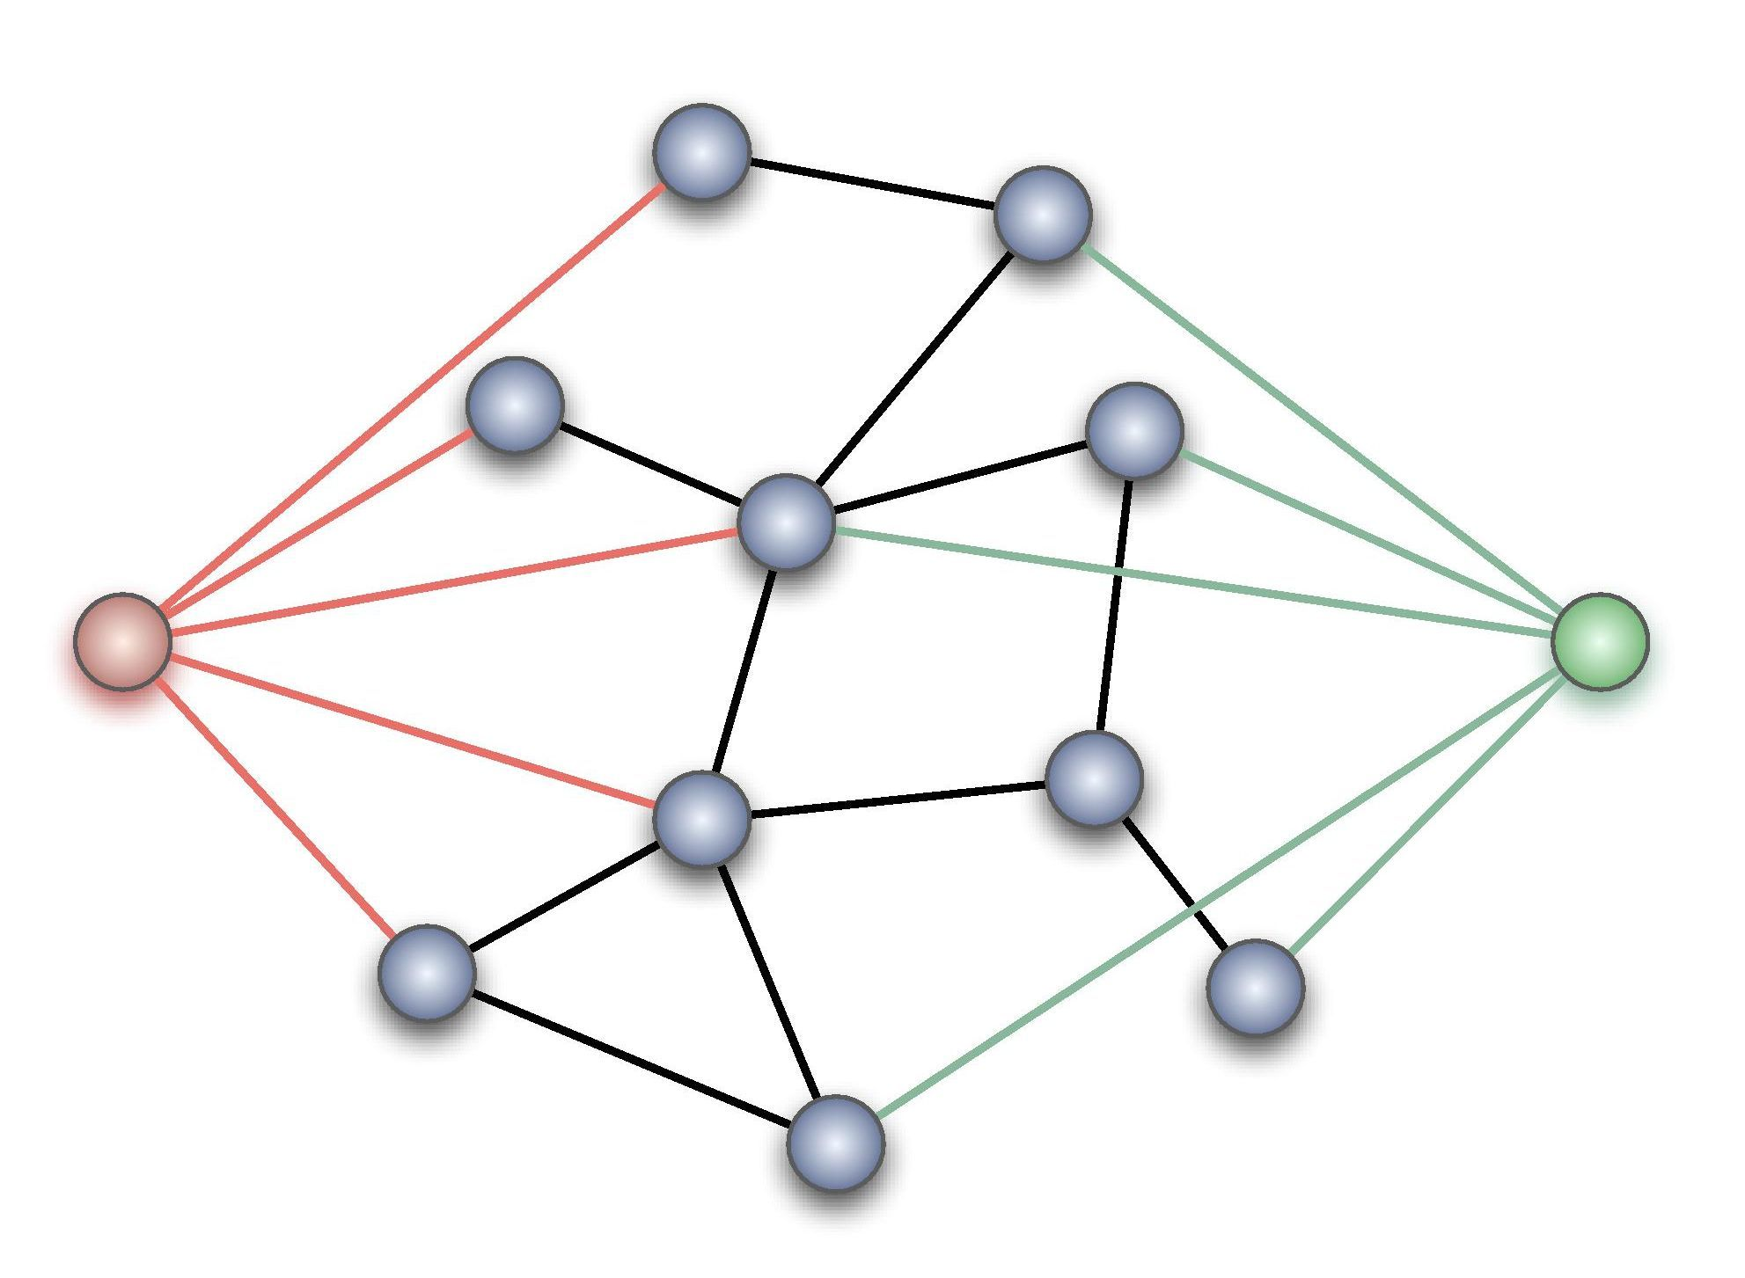
What is an architectural style?
A component is a basic architectural computational component – clients, servers, filters, layers, a database etc.
A connector provides the interaction between components.
A style is a vocabulary of possible components and connector types, and constraints on how they can be applied.
Given the above we can classify architectures:
What is the design vocabulary?
What are the allowed structural patterns?
What is the underlying computational model?
What are the essential invariants?

Slide 8
Boxology
Data Flow | Dominated by movement of data through the system, with no “upstream” content control by recipient | Pipes and Filters Batch Sequential
Data Centered | Dominated by a complex central data store manipulated by independent components | Repository Blackboards
Data Sharing | Dominated by sharing of data amongst components | Hypertext Systems Compound Document
Call & Return Systems | Dominated by order of computation, usually with a single thread of control | Procedural Object Oriented Naïve Client Server
Interacting Processes | Dominated by communication between independent, usually concurrent, processes | Event Driven (Implicit , Reactive, or Decoupled Invocation) Event Sourcing Broker SOA
Hierarchical Systems | Dominate by reduced coupling with the partition of the system into subsystems with limited interaction | Interpreters Rule-Based Systems Layers CQRS
Missing from this is obviously any discussion of User Interface styles. The question is whether MVC, for example, is simply a design pattern that fits into another one of these styles or has unique characteristics

Slide 9
Heterogeneous styles
Components
Connectors
Whilst we talk about styles in a pure form for understanding, most applications employ a combination of styles
The most common approach is hierarchical – a component identified in one style is itself implemented using another style
A single component might use different architectural connectors. A component might access a repository, but interact with other components through pipes and filters or implicit invocation
Elaborate a whole level of the architecture in a different style (as opposed to just a component)
A connector may be hierarchically decomposed as well
For example the pipe in a pipes and filters architecture might be implemented using messaging middleware, which is itself uses a heterogeneous architectural style such as repository and implicit invocation

Slide 10
Candidate model problems
How do we decide on the properties of a software architecture

Slide 11
Candidate Models
The models
Intended as a set of sample problems to allow comparison of the solution in different architectural styles.
The idea is that as the problems become well-known then discussion of proposed new architectures can dispense with a description of the problem and proceed to discussion of the solution
Because architectural styles are solving well-known problems, with well known properties comparison of the fitness of architectural styles becomes easier.
Keyword in Context (KWIC): Given a set of lines, create an alphabetized list of the rotations of those lines.
Sea Buoy: Collect and transmit weather data both automatically and on demand; allow preemption for emergency services.
Cruise Control: Maintain the speed of a vehicle.
Conference Refereeing: Solicit, referee, and select papers for a conference.
Mailing List Handler: Merge address information from multiple sources, eliminating duplicates and observing reader preferences.
Printer Spooler: Manage print jobs within a printer network.
Library: Automate traditional library tasks, such as check-in and check-out of books.
Automated Teller Machine (ATM): Provide the usual banking functions with a remotely-located machine.
Calendar Scheduler: Organize a meeting schedule.
Compiler: Translate source code for a programming language to executable form.
Mobile Robot: Design a mobile robot capable of executing tasks while monitoring the environment, e.g., avoiding obstacles.

Slide 12
KWIC
Keyword in Context originally proposed by Parnas to illustrate advantages of different designs [Parnas72]
For a text, a KWIC produces a permuted index
Every sentence is replicated and permuted in its words i.e. shift from left to right
Every first word of a permutation is sorted alphabetically and entered into the index
The KWIC system accepts an ordered set of lines
Each line is “circularly shifted” by repeatedly removing the first word and appending it to the end of the line
The output of a KWIC system is a listing of all circular shifts of all lines in alphabetical order

Slide 13
Brown fox jumped over the lazy dog the quick
Dog the quick brown fox jumped over the lazy
Fox jumped over the lazy dog the quick brown
Jumped over the lazy dog the quick brown fox
Lazy dog the quick brown fox jumped over the
Over the lazy dog the quick brown fox jumped
Quick brown fox jumped over the lazy dog the
The lazy dog the quick brown fox jumped over
The quick brown fox jumped over the lazy dog

Slide 14
Dataflow Styles

Slide 15

Pipes and Filters
Drivers
Need to process or transform a stream of data.
The task decomposes into steps.
Non-adjacent steps do not share information.
Explicit processing of steps by users is error prone.
Steps may need to be run in parallel.
We want to be open to extension but closed to modification.
The small processing steps are easier to re-use in new contexts than larger components.
The small processing steps are easier to test in isolation than within the whole.
We want multiple developers to work on the solution.

Slide 16
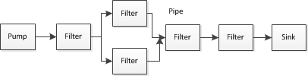
Pipes and Filters
Each component has an input and output. It reads a stream of data on the input and writes it on the output.
It applies a transformation to the input stream and writes it to the output stream. It applies the transformation incrementally, so that output begins before input is consumed. Hence the components are called filters.
The input is provided by a source or pump and flows into a sink. A file is a common example of both
The connectors serve as conduits for a stream of data, and thus are called pipes.
In a pipeline the topology is restricted to a linear sequence. In a bounded pipe, the amount of data in a pipe is restricted. In a typed pipe the data passed between two types is a well-defined type.

Slide 17
Invariants
Properties
Filters must be independent of each other.
A filters does not know the identity of the upstream or downstream filters from itself.
A specification may guarantee what is on an input pipe, and constrain what goes onto an output pipe, but not identify the filter.
Allow reasoning about the system as a composition of simple to understand components.
A filter can be re-used by being composed into new pipelines
New filters can be easily added, and old filters replaced
Filters are separate tasks and potentially parallel to each other.
Rapid prototyping by reusing existing filters

Slide 18
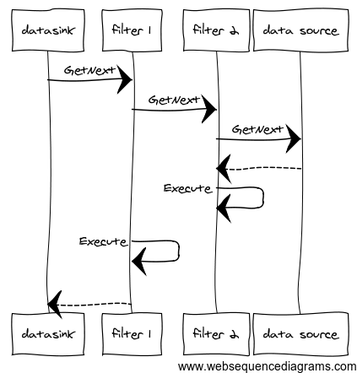
Pull pipeline
The data sink of each pipeline pulls data from upstream. In other words the end of the line initiates processing by pulling down from the source
Example: Any LINQ pipeline

Slide 19
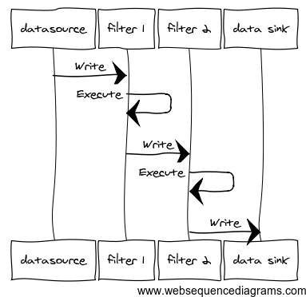
Push Pipeline
The data source pushes to the next components in the line. In other words the data source initiates processing by pushing to subsequent components
Example: An RX pipeline

Slide 20
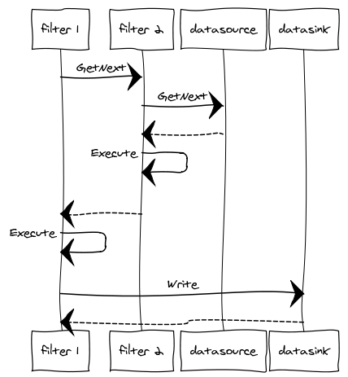
Push and Pull Pipeline
In this approach we combine both push and pull. We pull from a data source but we push to a data sink

Slide 21
Implementation
Divide the system’s task into a sequence of processing stages
A stage must depend only on the output of its predecessor
Define the data format to be passed along the pipe
UNIX uses line-structured ASCII text
Decide what represents ‘end-of-input’ so we know not to process further elements of that stream
Important not just for sink but for filters that must process all the stream –such as sorting – before passing on to their neighbour
Decide how to implement the pipe
How does the filter communicate with adjacent filters? The main choice here is between push and pull. Sometimes we talk about active filters, which control the process, and passive filters which only respond to an active filter.
Does the filter perform a direct call to the next filter, or does a separate pipe component control the sequencing of filters? The former is easier to implement, but the latter increases the flexibility for recomposing the pipeline as no modifications are required to the filter itself.
Decide how to implement the filters
A sequence of filters can be in-process or use multiple processes. An in-process component is the easiest to deliver and get under test. Multiple processes are easier to parallelize.
To parallelize an in-process pipeline requires separate threads for each filter, and concurrent queues for the pipe.
Multiple processes are inherently parallelized by the OS; they use middleware such as a message queue for the pipes.
To further parallelize use the competing consumer pattern that allows us introduce multiple instances of a filter, all consuming the same channel, and writing to the same channel. This may be easier with multiple processes as there is no need to deal with threading explicitly, instead relying on the OS to schedule.
Decide on error handling
A difficult question is how to notify errors from within the pipeline?
This can be easier in-process – just throw an exception that the pipeline initiator can catch to indicate an issue with the pipeline
UNIX uses a stderr pipe to report errors
Pipes and Filters may be implemented both in-process, using an in-memory pipeline, or as a distributed system using a message channel between independent processes that act as the filters.
Benefits from parallelization can be harder to realise than at first-glance. For example a sort filter has to read all the input, up to the end of stream marker, before it can sort.

Slide 22
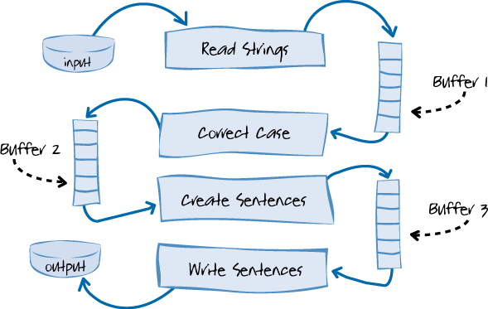
Parallel Execution
A pipes and filters architecture is inherently concurrent: it is divided into parts that could execute at the same time.
To run a pipes and filter architecture in parallel requires that we use threads, or separate processes.
In either case we execute the filter steps in parallel with each other.
We use a buffer for the pipe, such as a queue, because filter steps may complete and put work onto their output pipe, or read work from their input pipe at different rates. If we did not use a buffer, then we would lose output that could not be consumed yet. We also need to account for a consumer becoming ready to when the producer has not yet created fresh output, so we must be able to block until we are signalled that the buffer contains data
A message queue, such as MSMQ or RabbitMQ can act as a buffer, with each process reading from and writing to a queue.
We can also use a thread-safe in-process queue such as a BlockingCollection to allow us to run filters on their own threads and buffer the pipes between them.
The need to wait on the buffer if it is empty is often referred to as the Producer Consumer problem.

Slide 23
Examples
Disadvantages
Unix commands (stdin, stdout, stderr – everything is a file)
Document and Image processing
Encourage a ‘batch’ system approach as each component must process data independently
Poor at handling UI
Dependency on order of filters
Error handling difficult – what happens if an intermediate filter crashes
Incremental approach creates design challenges over batch approach (see batch-sequence)

Slide 24
Demos

Slide 25
Batch Sequence
Drivers
History
You have discrete tasks of a predetermined form, that occur at periodic intervals of time. For example you need to create over-night reports
We want to control when processing occurs to throttle access to shared resources. In particular we may want to prioritize interactive work over batch work
The task decomposes into steps.
Each step runs to completion before the next step begins
Explicit processing of steps by users is error prone.
We want to be open to extension but closed to modification.
The small processing steps are easier to re-use in new contexts than larger components.
The small processing steps are easier to test in isolation than within the whole.
We want multiple developers to work on the solution.
Mainframes with magnetic tape made extensive use of batch processing: data passed from one step to another is stored on tape.
An example model is: Validate the transactions on an input tape to an output tape; sort the valid transactions into timestamp sequence from that input tape to an output tape; update a store with the sorted transactions from the input tape and output the modified records; read the modified records output tape, and output a report
Hadoop uses a batch-sequence architecture to deal with big data. At the scale of hundreds of gigabytes or petabytes input data will not fit on a hard drive or in memory, so information needs to be distributed to multiple machines, and process work in parallel

Slide 26
Batch Sequence
Each component has an input and output. It reads a stream of data on the input and writes it on the output.
It applies a transformation to the input stream and writes it to the output stream.
It reads the whole of the stream before processing the data (often operations like sorting and sequencing require that approach). This lowers parallelism as later stages cannot begin processing until this stage is complete; it is however often simpler to understand.
Because it reads the whole of the stream the component is usually called a step or phase.
The sequence needs to be bounded as a component needs to know when it has read the complete stream in order to process it.
The input is provided by a source or pump and flows into a sink. A file is a common example of both
The connectors serve as conduits for a stream of data, and thus are called pipes.

Slide 27
Invariants
Properties
Steps must be independent of each other.
A step does not know the identity of the upstream or downstream steps from itself.
A specification may guarantee what is on an input, and constrain what goes onto an output, but not identify the step.
Allow reasoning about the system as a composition of simple to understand components.
A step can be re-used by being composed into new batch sequences
New steps can be easily added, and old steps replaced
It may be possible to parallelize a step, and buffer inputs, but because the prior step must run to completion competing consumer models of parallelism are not possible
Rapid prototyping by reusing existing steps

Slide 28
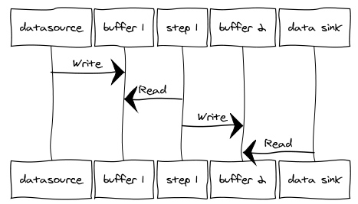
Batch Sequence
Each filter reads from its input and writes to its output. This results in a push-pull model between steps.

Slide 29
Implementation
Divide the system’s task into a sequence of processing stages
A stage must depend only on the output of its predecessor
Define how data will be exchanged between stages
This may be as simple as an in-memory bounded collection, a file or database, or messaging
The decision here is the degree of coupling that is acceptable: (tight) database, in-memory (loose) file, messaging
Decide what represents ‘end-of-input’ so we know not to process further elements in the batch
Does the step perform a direct call to the next step, or does a separate batch controller manage the steps? The former is easier to implement, but the latter increases the flexibility for recomposing the sequence as no modifications are required to the step itself.
Decide how to implement the steps
A sequence of filters can be in-process or use multiple processes. An in-process component is the easiest to deliver and get under test.
To parallelize an in-process pipeline requires separate threads for each steps, and concurrent queues for the buffer.
Multiple processes are inherently parallelized by the OS; they use middleware such as a message queue for the buffer.
Decide on error handling
A difficult question is how to notify errors from within the steps?
This can be easier in-process – just throw an exception that the pipeline initiator can catch to indicate an issue with the pipeline
Common to create a separate error output for any transactions in the batch that cannot be processed
Batch sequence may be implemented both in-process, using an in-memory pipeline, or as a distributed system using a message channel between independent processes that act as the steps.

Slide 30
Examples
Disadvantages
Compilers
Hadoop big data
Typical web-based application
Client sends request to server via HTTP
Web server reads request
Processes database queries
Renders web page
Returns HTTP response to user
Encourage a ‘batch’ system approach as each component must process data independently
Poor at handling UI
Dependency on order of filters
Error handling difficult – what happens if an intermediate filter crashes
Incremental approach creates design challenges over batch approach (see batch-sequence)

Slide 31
Q&A

